Slide 1
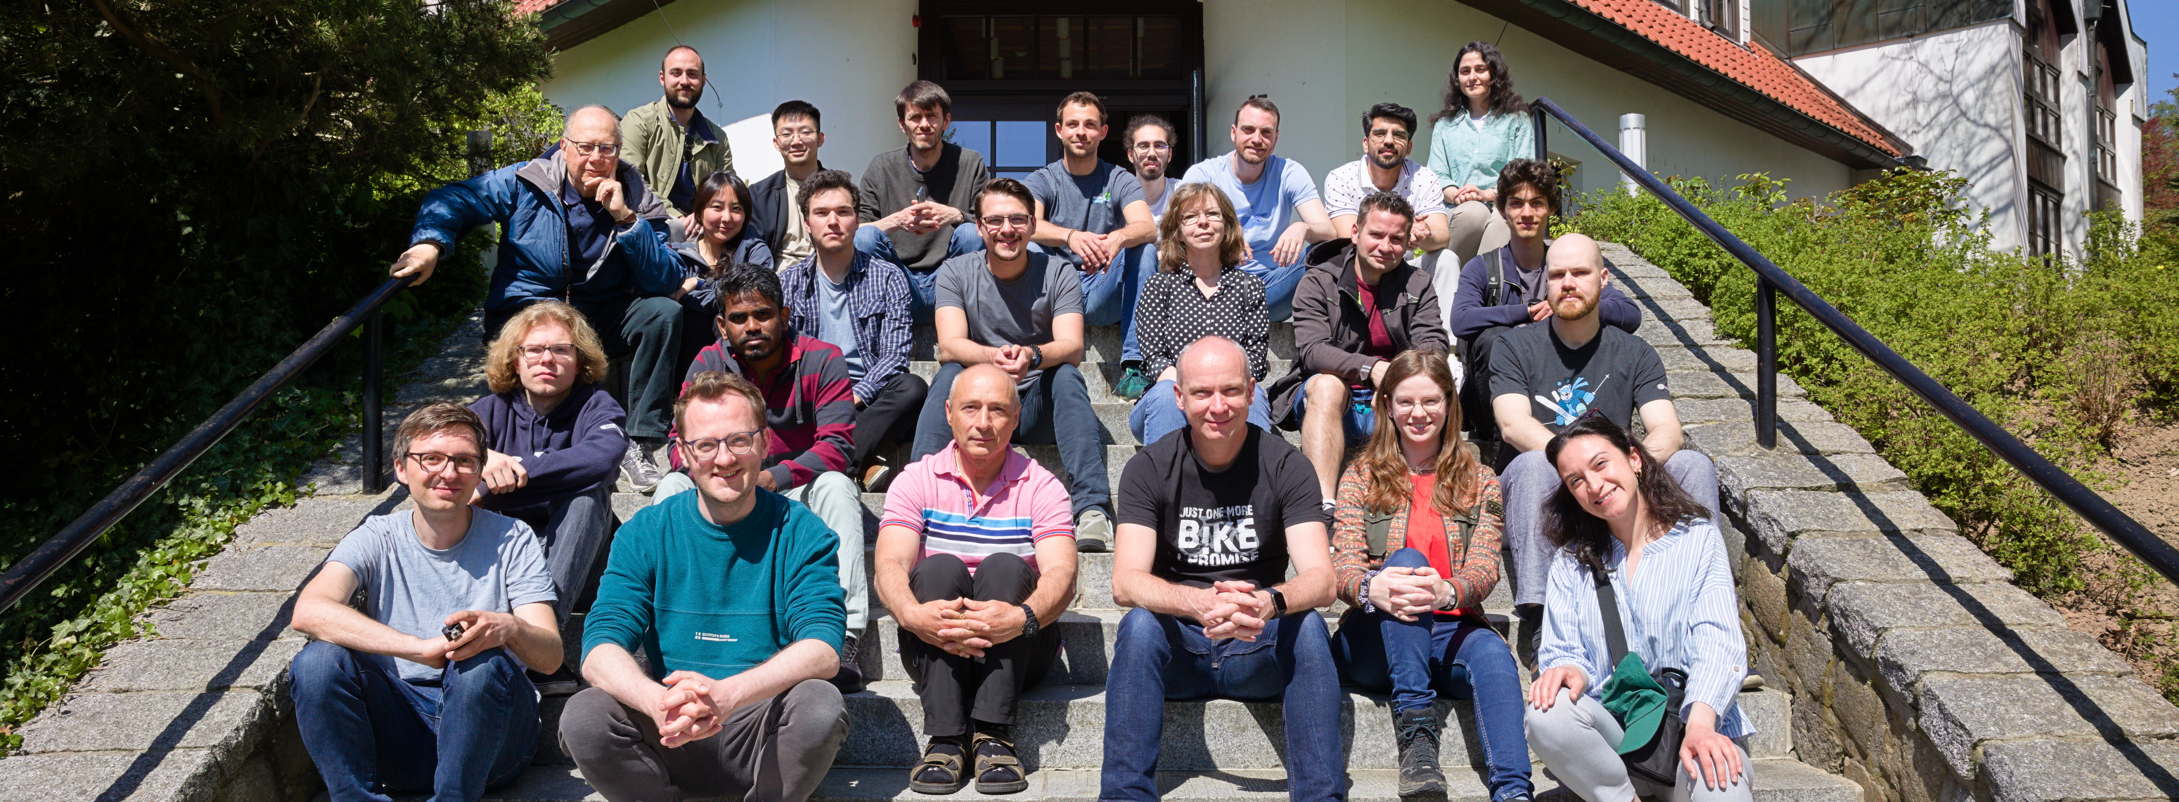
Molecular Communications: Applications and Challenges
Jorge Torres Gómez | Telecommunication Networks

Slide 2
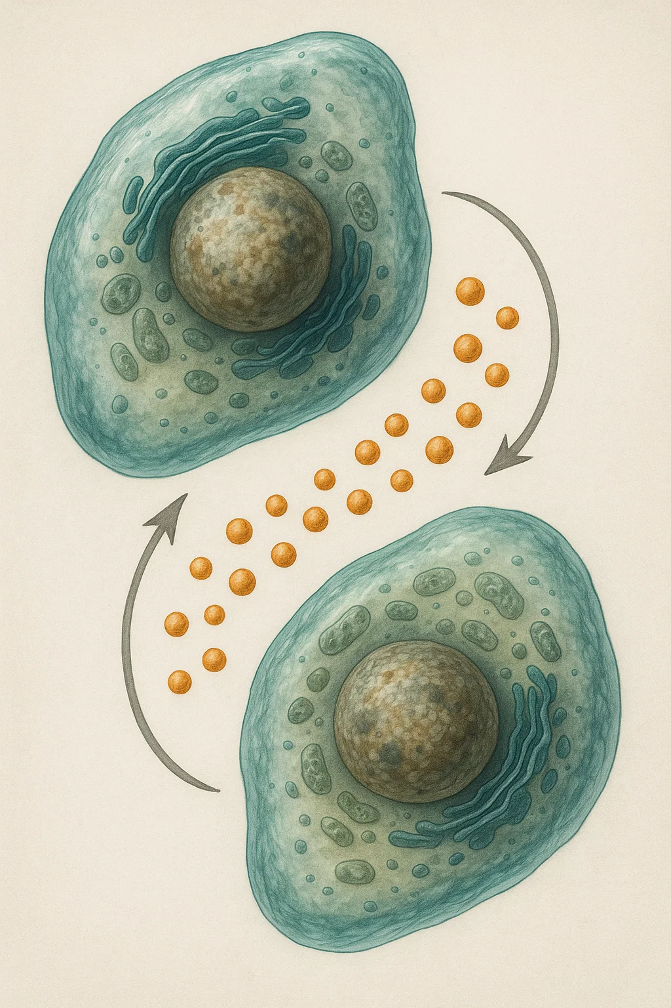

Cell-to-Cell Communications
Signalling Mechanisms:
Cell division
Regulation of gene expression
Detect signs of infections
[1] B. Alberts, D. Bray, and K. Hopkin, Essential Cell Biology, 4th rev ed. edition. New York, NY: Norton & Company, 2014.

Slide 3
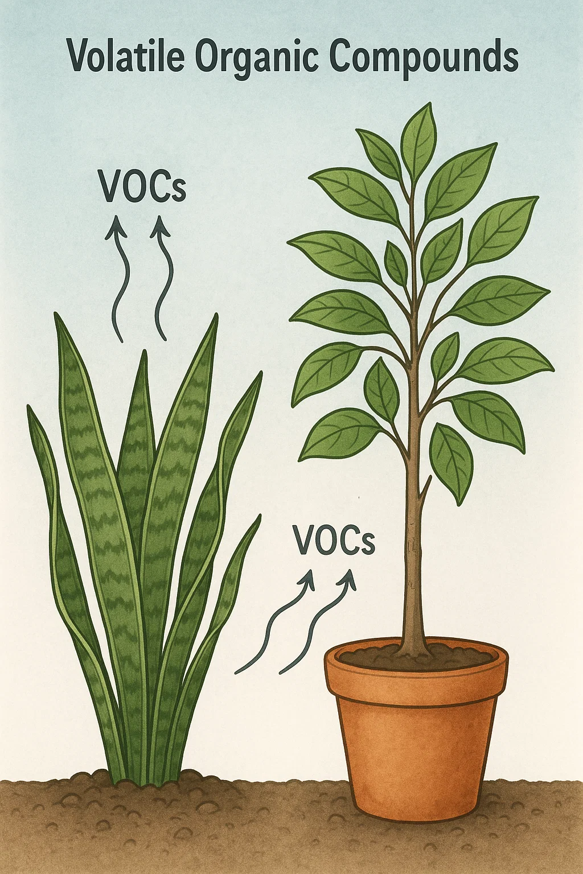
Plant-to-Plant Communications
Plant response to stress
Herbivore attacks
Environmental changes
[1] F. Gulec, H. Awan, N. Wallbridge, V. Sa, and A. W. Eckford, “Phytobiome: A Molecular Communication Network Within and Around Plants,” presented at the 9th Workshop on Molecular Communications, 2025.

Slide 4
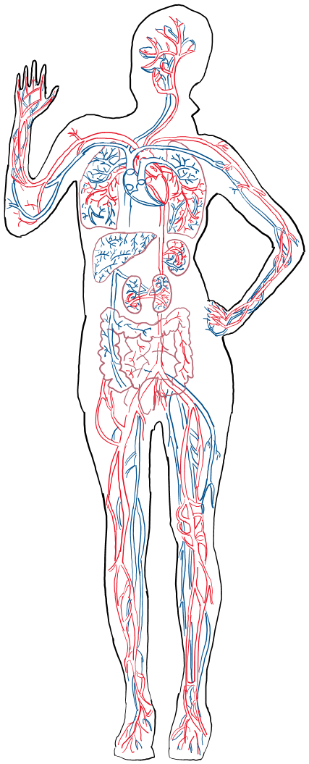





Internet of Bio-Nano-Things
Gateway
Remote
Monitor
nanosensor
Wound

Slide 5
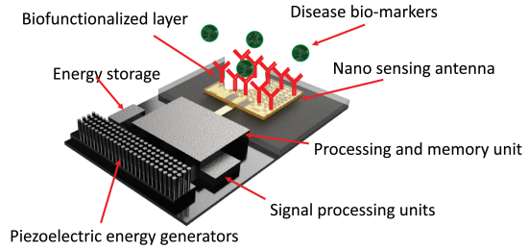
Internet of Bio-Nano-Things
Gateway
Remote
Monitor
nanosensor
Wound
[1] A. Sangwan and J. M. Jornet, "Joint Communication and Bio-Sensing With Plasmonic Nano-Systems to Prevent the Spread of Infectious Diseases in the Internet of Nano-Bio Things," in IEEE Journal on Selected Areas in Communications, vol. 40, no. 11, pp. 3271-3284, Nov. 2022, doi: 10.1109/JSAC.2022.3214288.

Slide 6
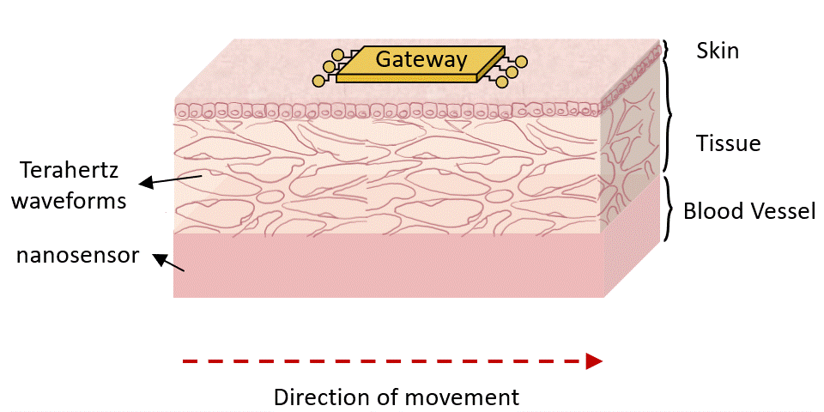
Nanoantenna

Slide 7
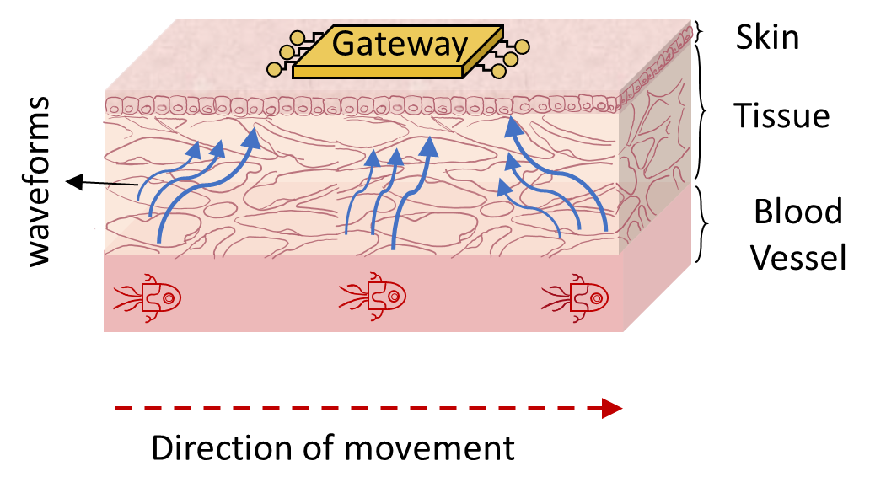
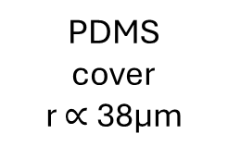
Nanoantenna
Blood
Graphene
radiator
Quartz
substrate
PDMS
cover
r $∝$38μm
Air

Slide 8
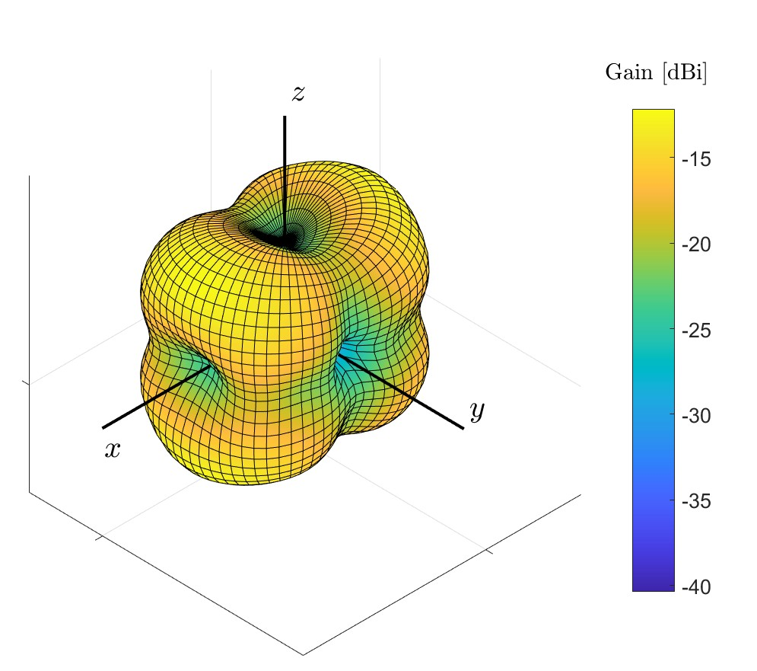
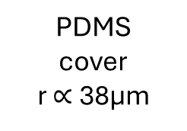
Implanted Nanoantenna
Blood
Graphene
radiator
Quartz
substrate
PDMS
cover
r $∝$38μm
Air

Slide 9
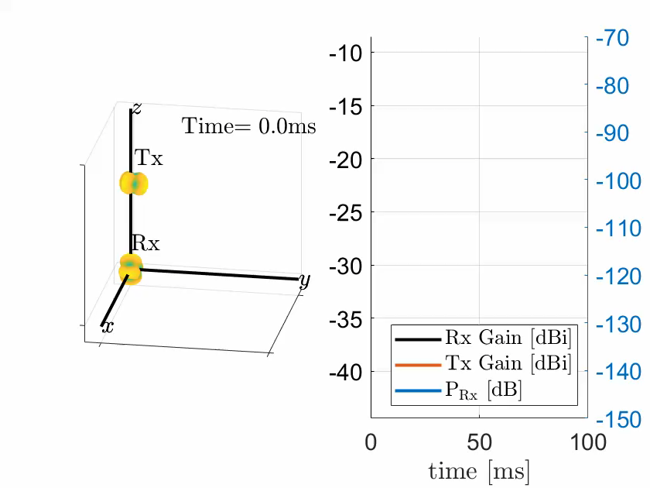
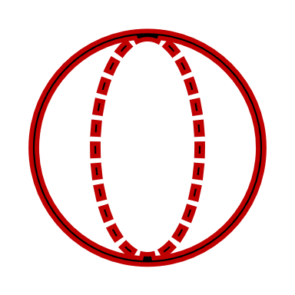
vessel wall
Nano device
Radiation pattern
Radiation pattern
Nano device

Slide 10
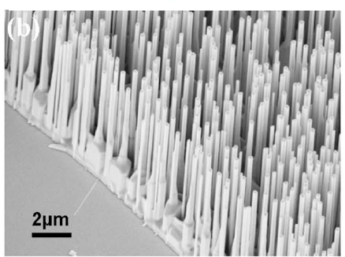
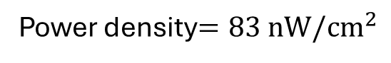
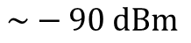
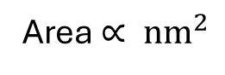
Transmission Power
Piezo Electric Generators
Transmission
Power
Power density$=83 nW/{cm}^{2}$
Area $∝ {nm}^{2}$
$$\sim −90 dBm$$
Jin Liu, Peng Fei, Jun Zhou, Rao Tummala, Zhong Lin Wang; Toward high output-power nanogenerator. Appl. Phys. Lett. 28 April 2008; 92 (17): 173105.

Slide 11
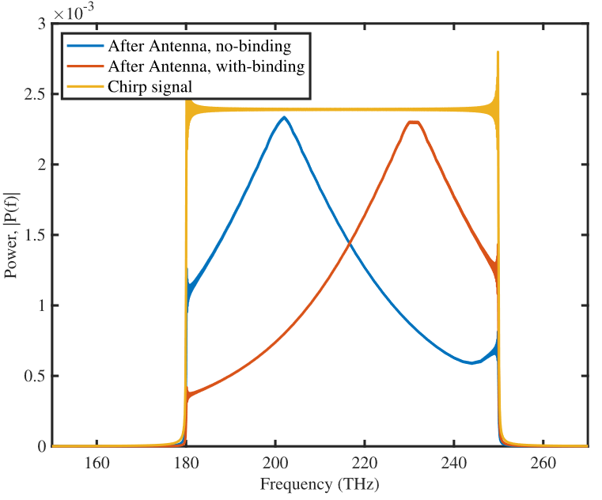

Nanosensors
[1] A. Sangwan and J. M. Jornet, “Joint Communication and Bio-Sensing With Plasmonic Nano-Systems to Prevent the Spread of Infectious Diseases in the Internet of Nano-Bio Things,” IEEE Journal on Selected Areas in Communications, vol. 40, no. 11, pp. 3271–3284, Nov. 2022, doi: 10.1109/JSAC.2022.3214288.

Slide 12
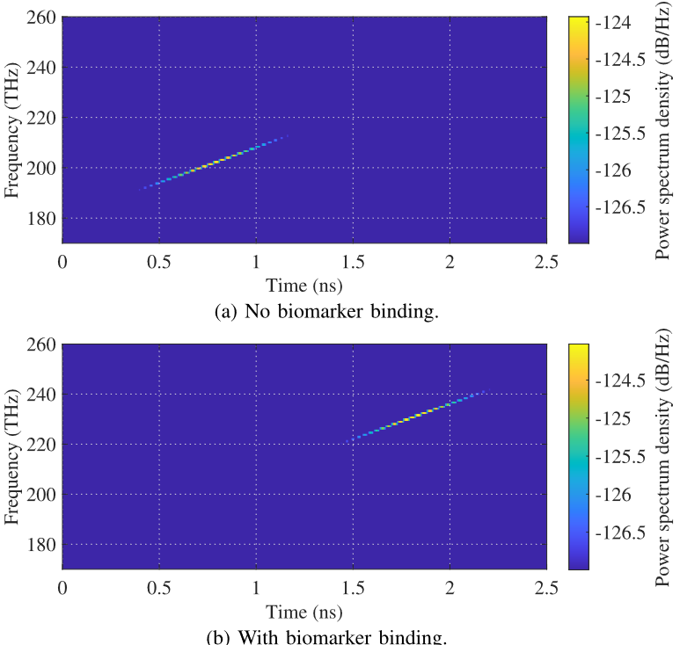
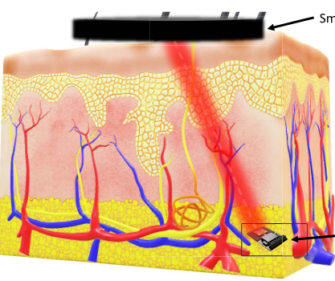
Nanosensors
Gateway
[1] A. Sangwan and J. M. Jornet, “Joint Communication and Bio-Sensing With Plasmonic Nano-Systems to Prevent the Spread of Infectious Diseases in the Internet of Nano-Bio Things,” IEEE Journal on Selected Areas in Communications, vol. 40, no. 11, pp. 3271–3284, Nov. 2022, doi: 10.1109/JSAC.2022.3214288.

Slide 13
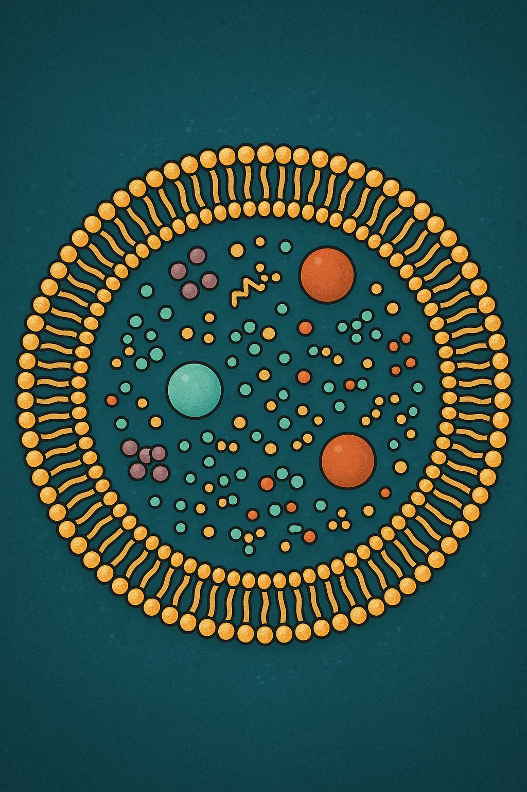


Bio-Building Carriers
Cancer Cell
[1] C. A. Söldner et al., “A Survey of Biological Building Blocks for Synthetic Molecular Communication Systems,” IEEE Communications Surveys Tutorials, vol. 22, no. 4, pp. 2765–2800, Fourthquarter 2020.

Slide 14




Bio-Building Carriers
Cancer Cell
$$C$$
$$d_{0}$$
$$d$$

Slide 15
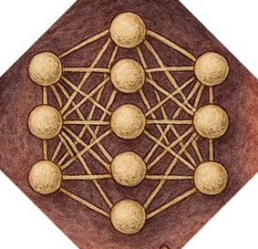
Bio-Building Carriers
Cancer Cell
$$C$$
$$d_{0}$$
$$d$$

Slide 16
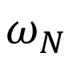
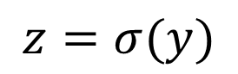
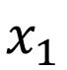


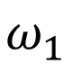

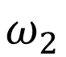
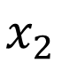
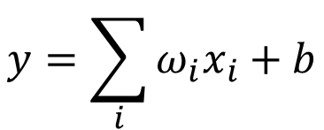
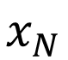
Bio-Computing
Single Neuron Scheme
$$b$$
Activation
Function
$$x_{1}$$
$$ω_{N}$$
$$y=\sum_{i}{ω_{i}x_{i}}+b$$
$$z=σ(y)$$
$$x_{2}$$
$$ω_{2}$$
$$+$$
$$⋯$$
$$x_{N}$$
$$ω_{1}$$
16

Slide 17
Bio-Computing
Digital Computing
Chemical Reaction Networks
DSP
Microfluidic Chips
Analog Computing
Wet-Neuromorphic Computing
Chemical Reaction Networks
Compartment Based Models
Reservoir Computing
17

Slide 18

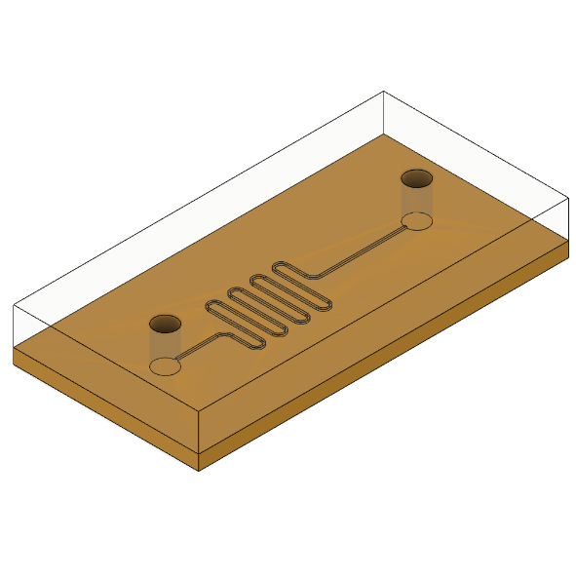
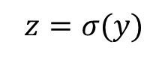
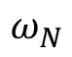

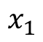

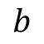
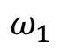
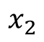
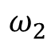
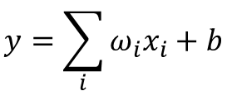
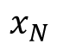
Bio-Computing
Digital Computing
Chemical Reaction Networks
DSP
Microfluidic Chips
Single Neuron Scheme
$$b$$
Activation
Function
$$x_{1}$$
$$ω_{N}$$
$$y=\sum_{i}{ω_{i}x_{i}}+b$$
$$z=σ(y)$$
$$x_{2}$$
$$ω_{2}$$
$$+$$
$$⋯$$
$$x_{N}$$
$$ω_{1}$$
Chemical
Reaction
[1] A. O. Bicen and I. F. Akyildiz, “System-Theoretic Analysis and Least-Squares Design of Microfluidic Channels for Flow-Induced Molecular Communication,” IEEE Transactions on Signal Processing, vol. 61, no. 20, pp. 5000–5013, Oct. 2013, doi: 10.1109/TSP.2013.2274959.
18

Slide 19
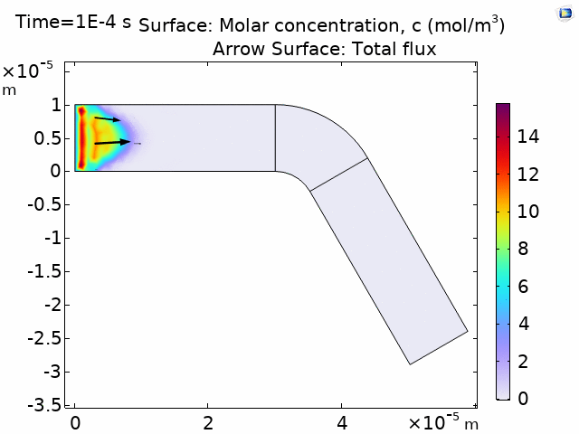
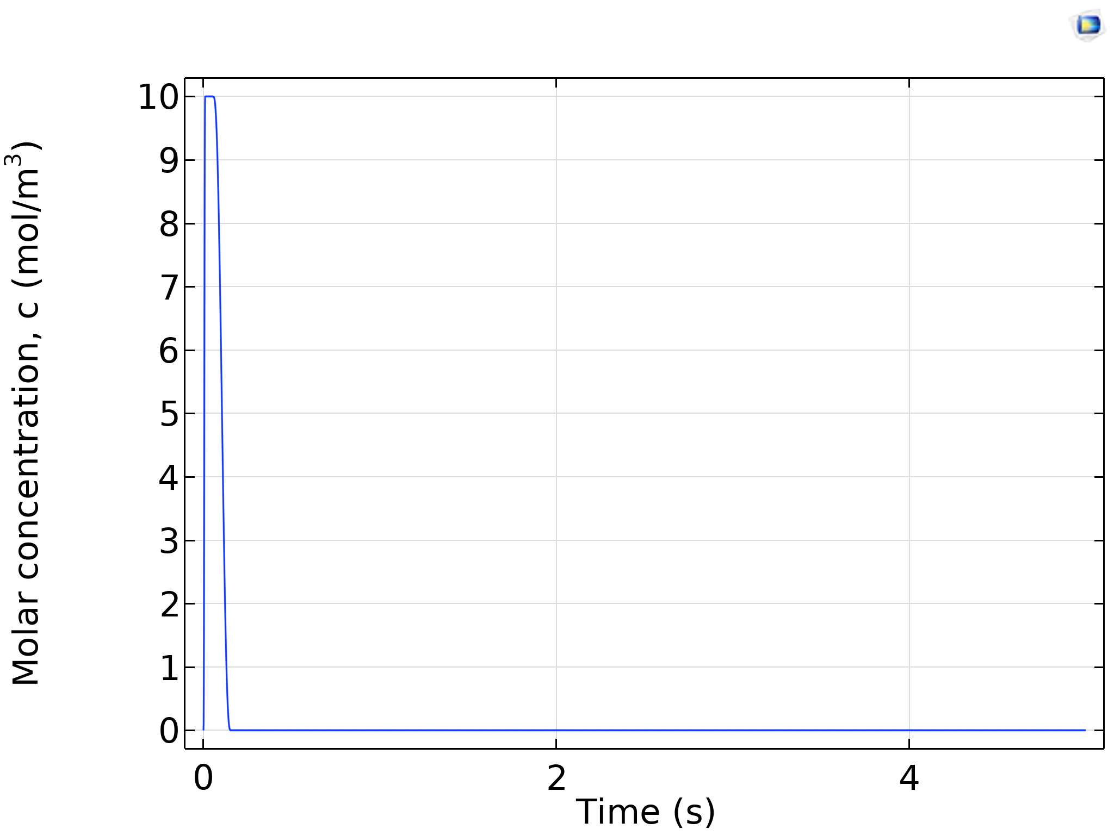
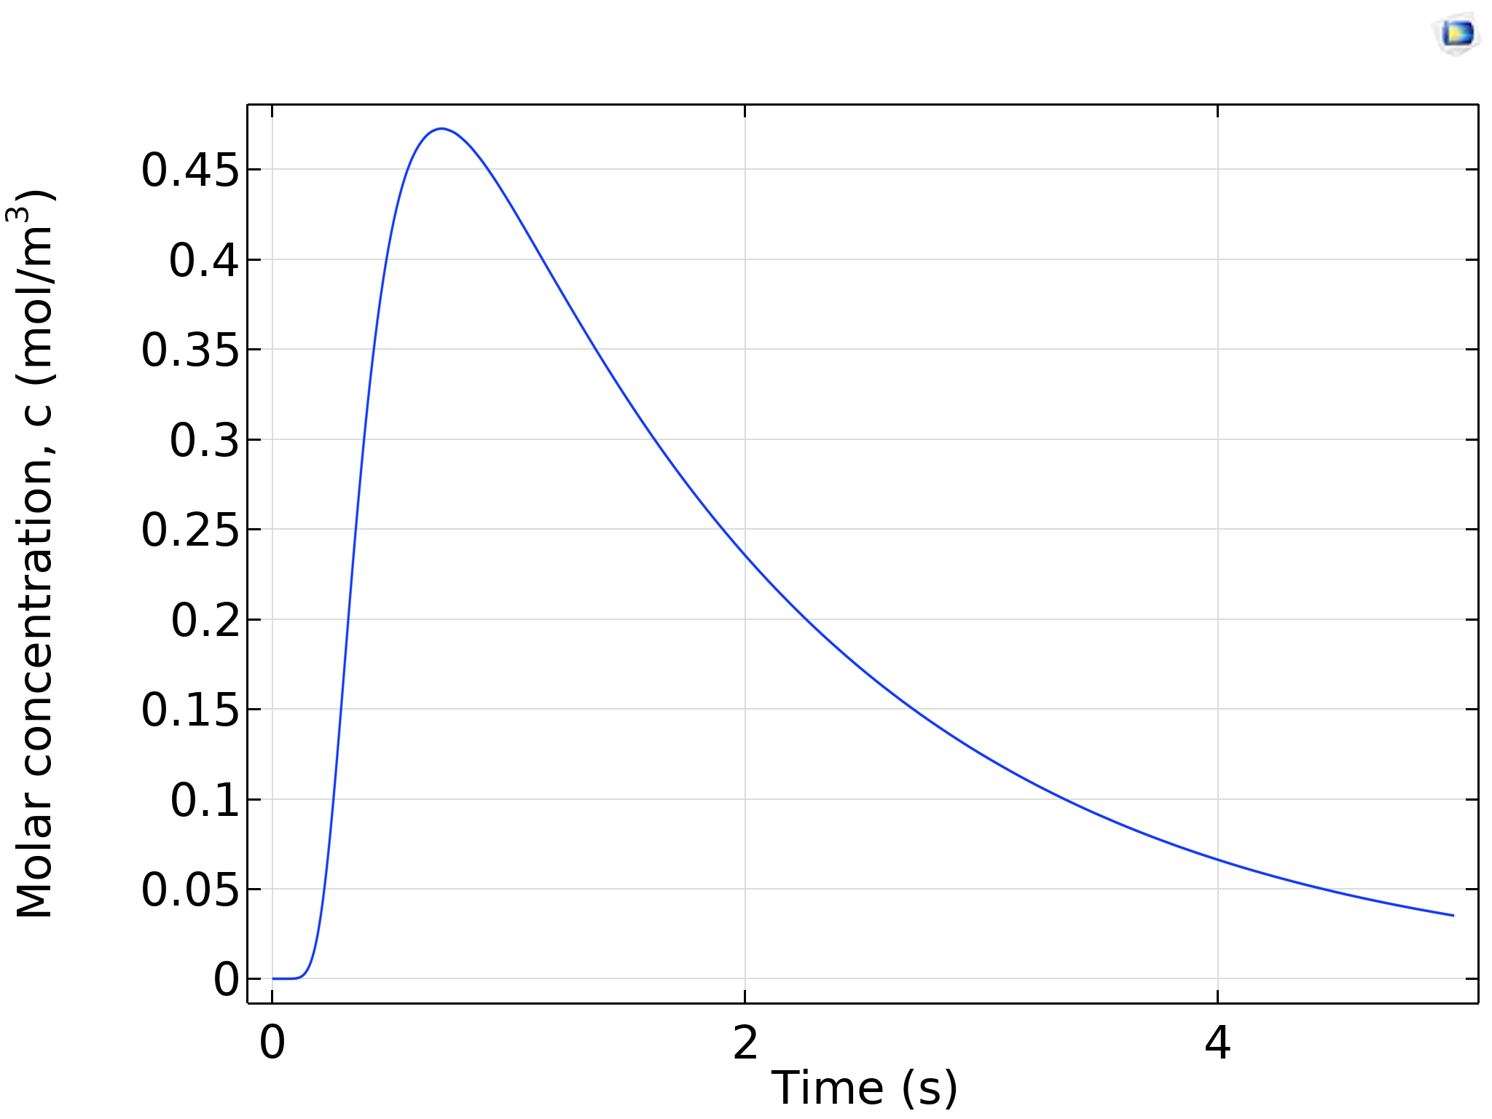
Bio-Computing
Digital Computing
Chemical Reaction Networks
DSP
Microfluidic Chips
19

Slide 20
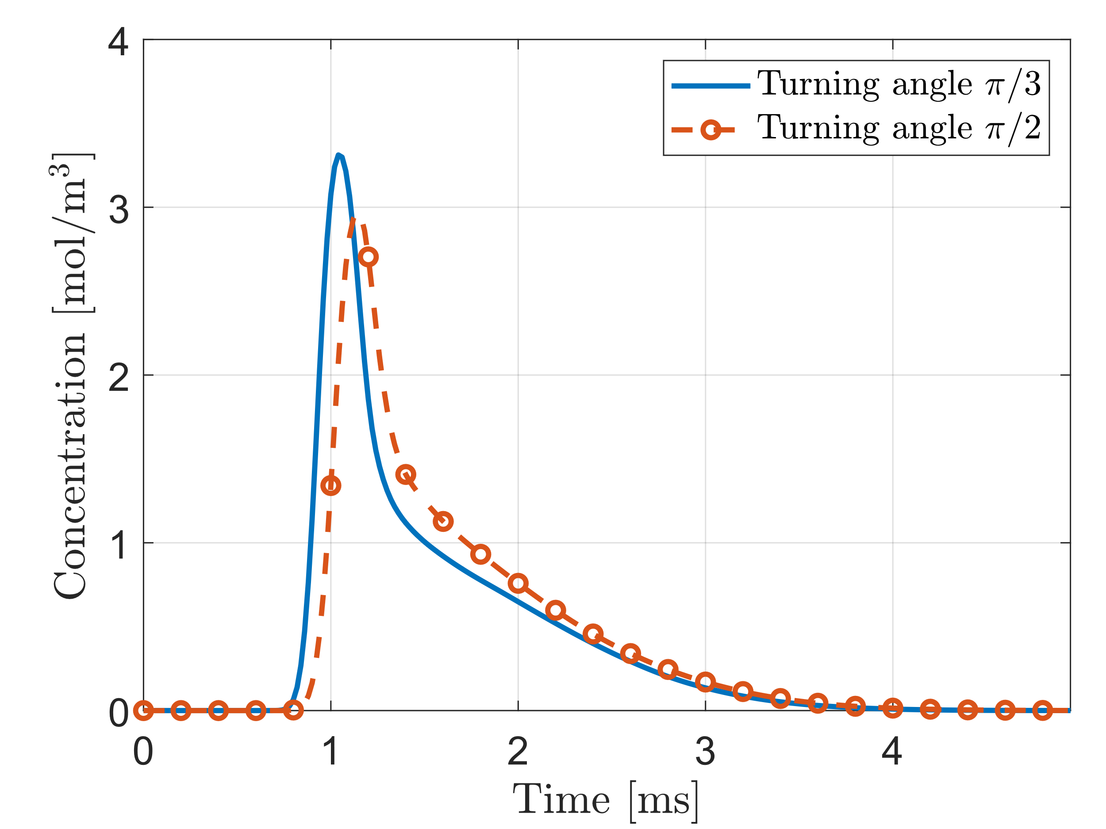
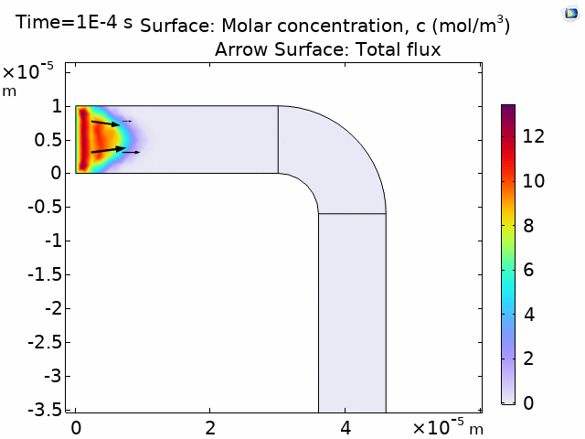
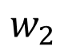
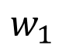
$$w_{1}$$
$$w_{2}$$
20

Slide 21
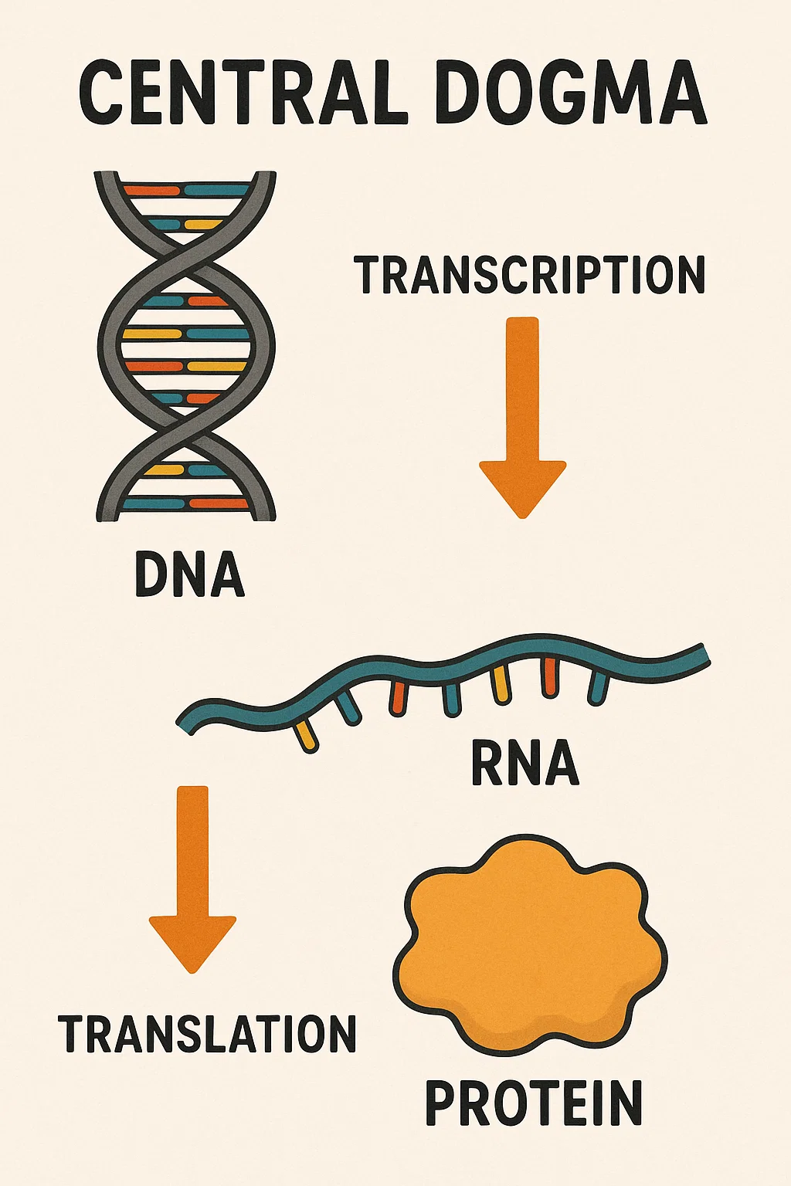
Bio-Computing
Analog Computing
Wet-Neuromorphic Computing
Chemical Reaction Networks
Compartment Based
Models
Reservoir Computing
Gene Regulatory Networks (GRN)
J. Perera et al., “Wet-Neuromorphic Computing: A New Paradigm for Biological Artificial Intelligence,” IEEE Intelligent Systems, pp. 1–7, 2025. DOI: 10.1109/mis.2025.3555551.
21

Slide 22
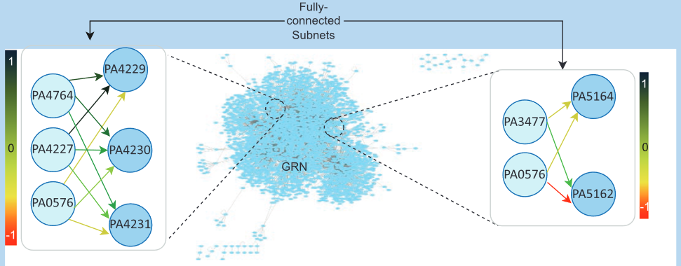
Bio-Computing
Analog Computing
Wet-Neuromorphic Computing
Chemical Reaction Networks
Compartment Based
Models
Reservoir Computing
Gene Regulatory Networks (GRN)
J. Perera et al., “Wet-Neuromorphic Computing: A New Paradigm for Biological Artificial Intelligence,” IEEE Intelligent Systems, pp. 1–7, 2025. DOI: 10.1109/mis.2025.3555551.
22

Slide 23
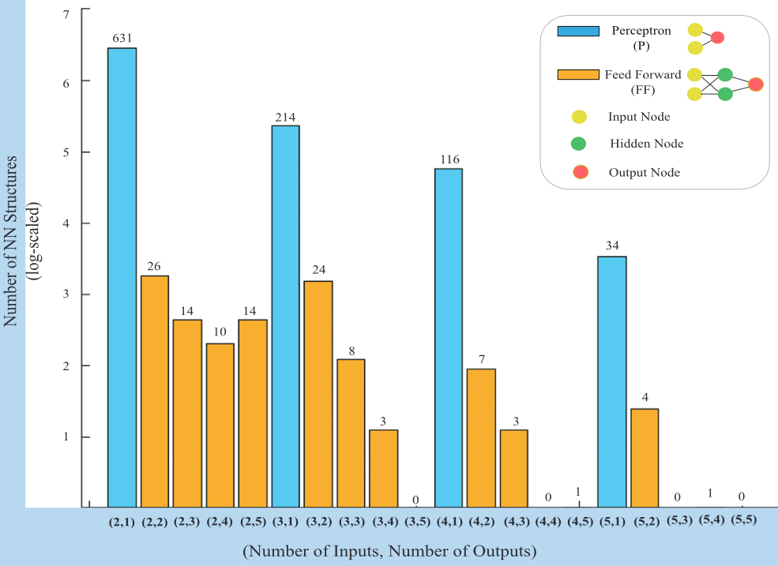
Bio-Computing
[1] S. Balasubramaniam, S. Somathilaka, S. Sun, A. Ratwatte, and M. Pierobon, “Realizing Molecular Machine Learning Through Communications for Biological AI,” IEEE Nanotechnology Magazine, vol. 17, no. 3, pp. 10–20, Jun. 2023, doi: 10.1109/MNANO.2023.3262099.
23

Slide 24
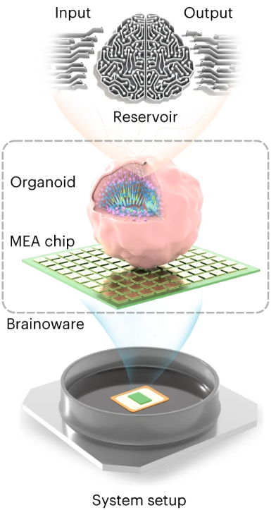

Bio-Computing
Analog Computing
Wet-Neuromorphic Computing
Chemical Reaction Networks
Compartment Based
Models
Reservoir Computing
J. Perera et al., “Wet-Neuromorphic Computing: A New Paradigm for Biological Artificial Intelligence,” IEEE Intelligent Systems, pp. 1–7, 2025. DOI: 10.1109/mis.2025.3555551.
24

Slide 25

Bio-Computing
Digital Computing
Chemical Reaction Networks
DSP
Microfluidic Chips
Analog Computing
Wet-Neuromorphic Computing
Chemical Reaction Networks
Compartment Based Models
Reservoir Computing
$\sim 300$ learnable parameters
25

Slide 26
Molecular Communications: Applications and Challenges
Jorge Torres Gómez | Telecommunication Networks

